Slide 1
2024-2025
Junior Expectations
Josh Gordon
College Access Specialist
jgordon@bisdtx.org

Slide 2
What will my school week look like?
Juniors are taking classes at ACC Elgin campus Monday and Wednesday and are at CRCA on Tuesdays, Thursdays, and Fridays.
Juniors are enrolled in the following classes for the FALL semester:
HIST-1301 US History I (3 credits)
ENGL-1301 English Composition I (3 credits)
HUMA-1302 Renaissance to Present (3 credits),
MATH-1332-Contemporary Math (3 credits),
Or MATH-1414 College Algebra (3 credits)
Cat has a hat

Slide 3
What will my school week look like?
Juniors are enrolled in the following classes for the SPRING semester:
HIST-1302 US History 2 (3 credits)
ENGL-1302 English Composition 2 (3 credits)
1 other course (3 credits)
With a Total of 35 total college credits from all three years
Cat has a hat

Slide 4
Repeating ACC Classes
The cost of courses/ books that are being repeated because the student withdrew from, failed, or earned a D in the course the previous semester or year, will be paid by the student and their family.
The current tuition ACC charges CRCA students is $150 per course.
Payments for repeated or in lieu of courses, including those taken during the summer, will be made to CRCA and are due by the last day of drop.
Cat has a hat

Slide 5
Satisfactory Academic Progress (SAP)
It is absolutely essential that you maintain or achieve the following in order to qualify for state and federal financial aid for you undergraduate college education:
A MINIMUM of 2.0 GPA
A MINIMUM of a 67% Completion Rate
Cat has a hat

Slide 6
Junior Expectations
Mr. Gordon’s main responsibility is to assist you in transitioning from a K-12 student to an adult/ college student.
You must come to class prepared and ready to learn. This includes:
Bringing your laptop, fully charged, and your power cord
Keeping your phone and earbuds in your backpack
Using the restroom BEFORE going to class
Cat has a hat

Slide 7
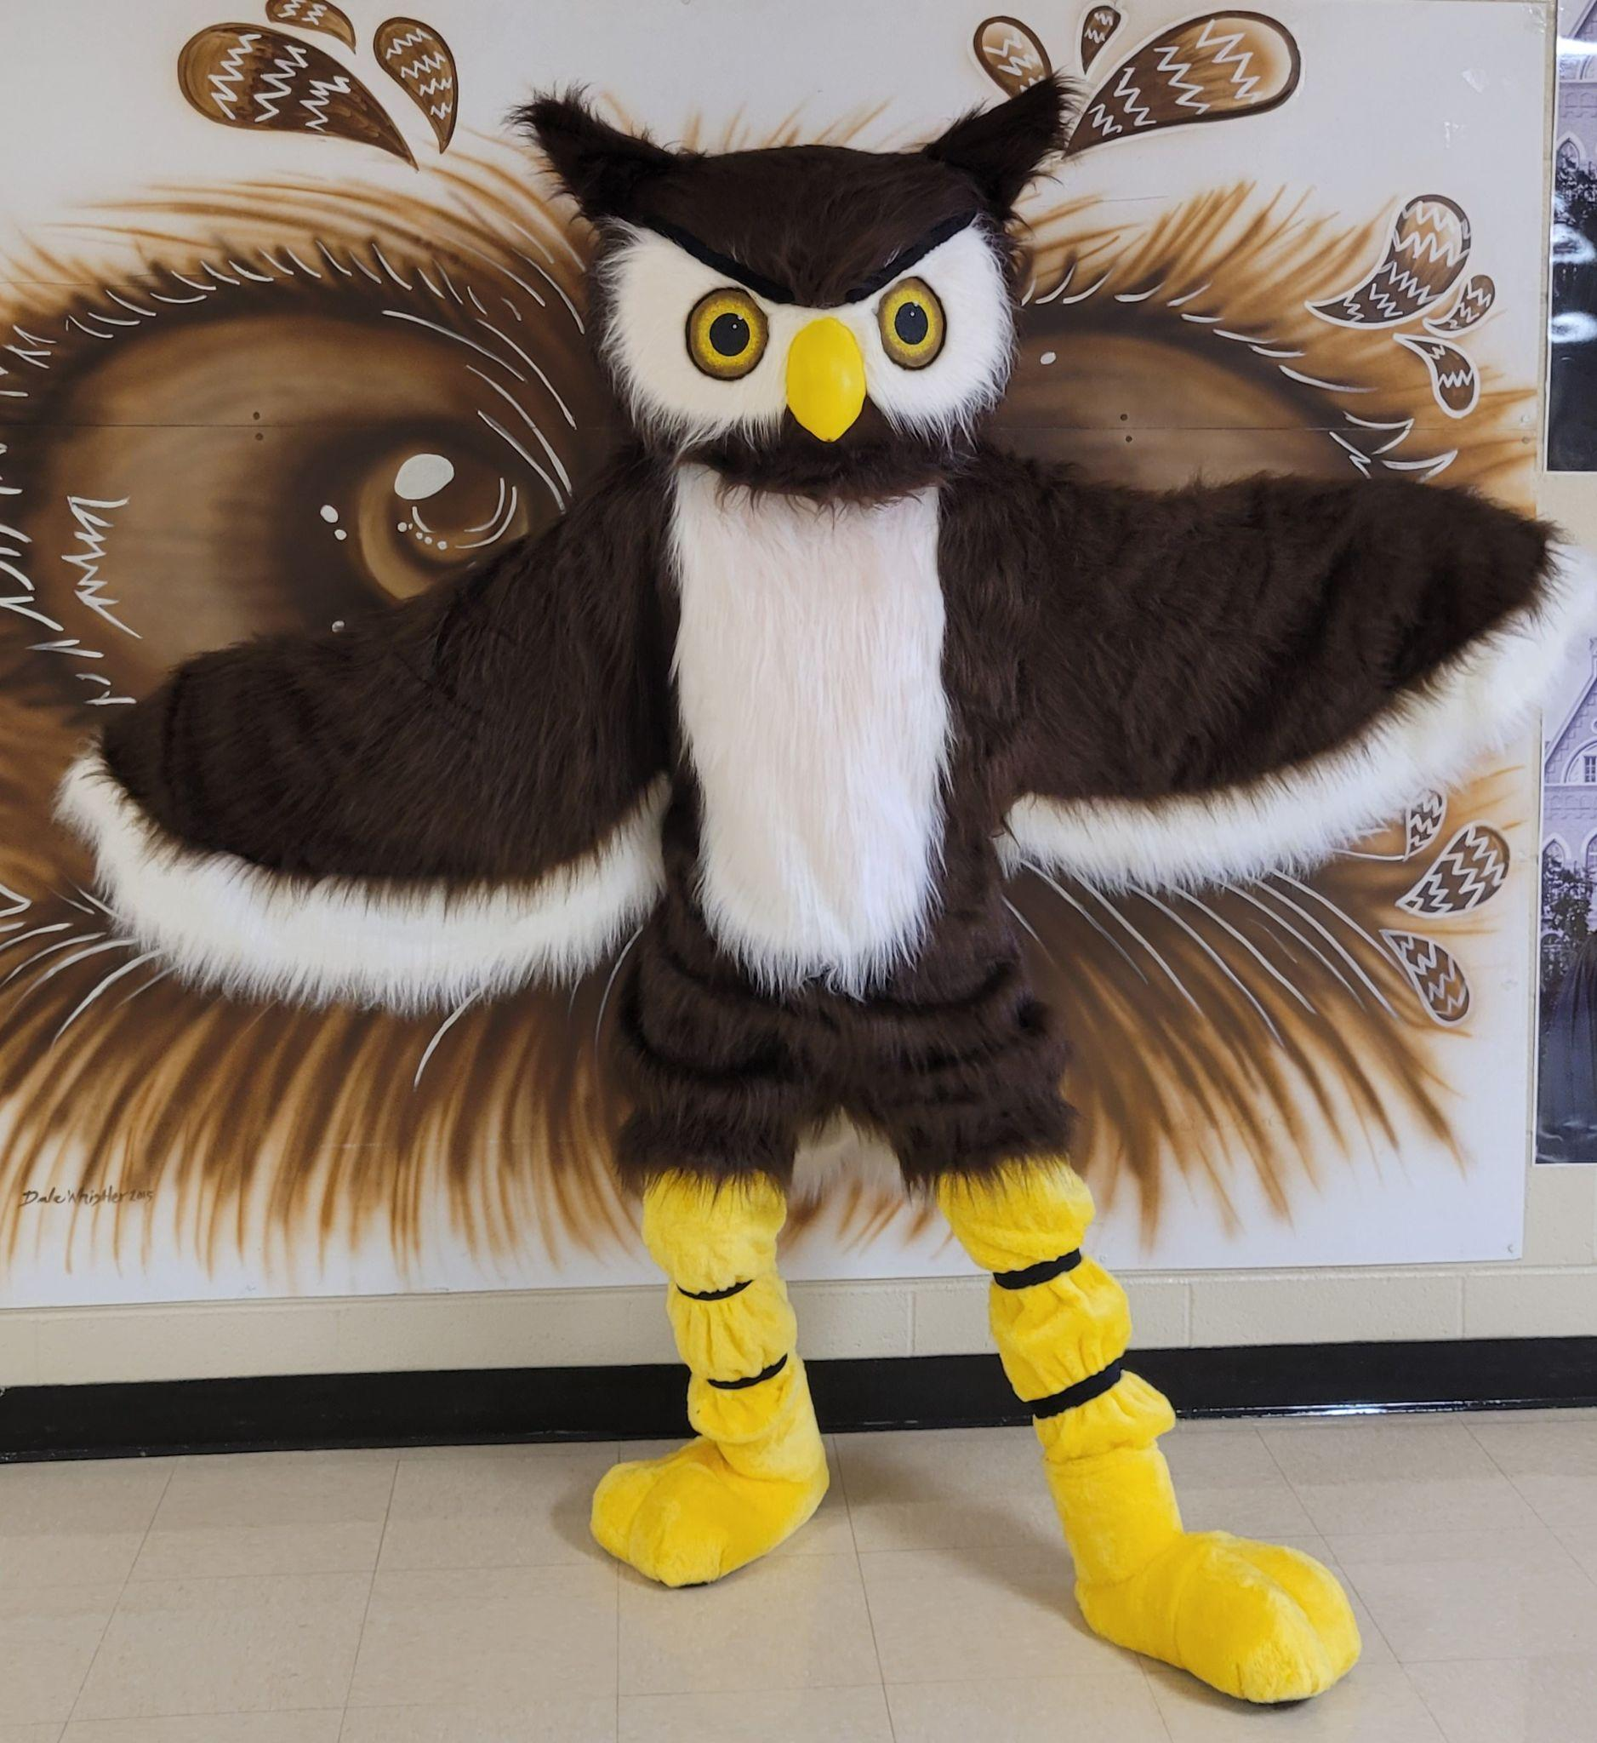
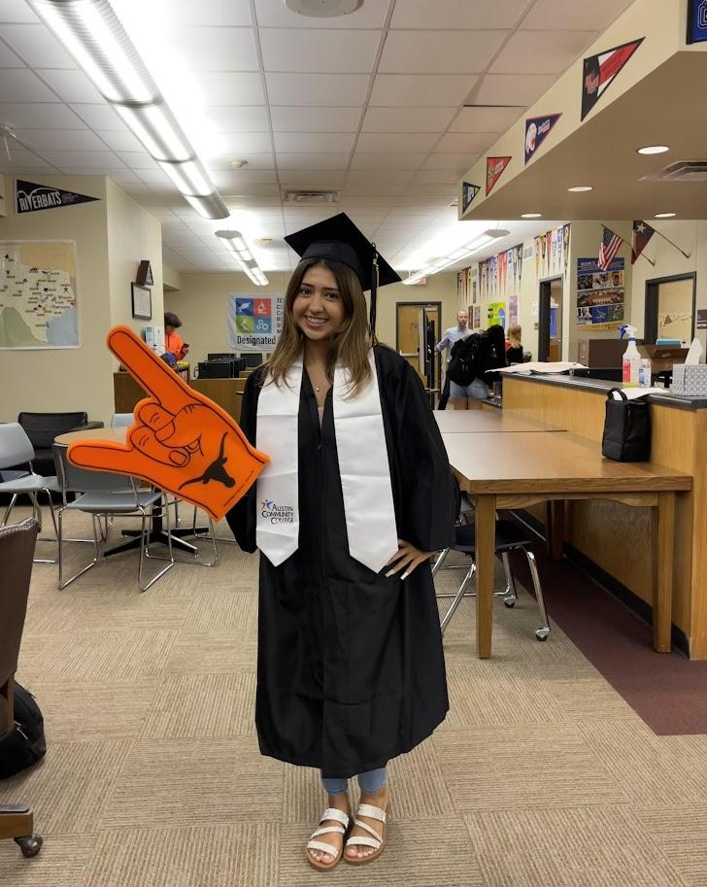
Junior Expectations
The Bus leaves CRCA at 9:00 AM. If you are running late, please call the front office. You may be responsible for finding your own transportation to Elgin.
Keep the bus clean.
The bus will leave ACC at 3:15 PM from where Mr. Gordon drops you off.
Cat has a hat

Slide 8
Junior Expectations
If you are able to drive yourself, you must present your driver’s license and insurance card to the front desk.
You must also get an ACC parking pass.
See link in the Google Classroom.
Cat has a hat

Slide 9
What’s Next?
4 year University
Continue at Community College
Trade/ Technical School
Military
Job
Cat has a hat

Slide 10
What Do Colleges Look At?
Grades/GPA/Class Rank
Courses
Essays (essay prompt is in the Google Classroom)
Letters of recommendation
Extracurricular activities, awards, volunteer hours
Employment
Cat has a hat

Slide 11
What About the SAT/ ACT?
Many universities are not requiring the SAT or ACT.
Getting a good score, however, could help students get in a better school or receive scholarships.
We are requiring all Juniors to take the SAT at least once in the Spring Semester.
Most colleges will accept either the SAT or ACT.
SAT fee waivers are available from Mrs. Jimenez. Fee waivers can also be used for college applications. Must be eligible for free or reduced lunch.
Cat has a hat

Slide 12
Six Goals for Junior Year
Begin to narrow down College List
Create a College Resume
Consider who to ask for Letters of Recommendation
Rough Draft College Essay
Register for and take the SAT or ACT
Continue getting good grades, being involved in extracurricular activities, and logging community services hours.
Cat has a hat

Slide 13
THANK YOU!
Are there any questions?

